Slide 1
Transformers
Lucas Beyer lbeyer@google.com
Modified by Pierre Tassel: pierre.tassel@aau.at

Slide 2
The classic landscape:
One architecture per "community"

Slide 3

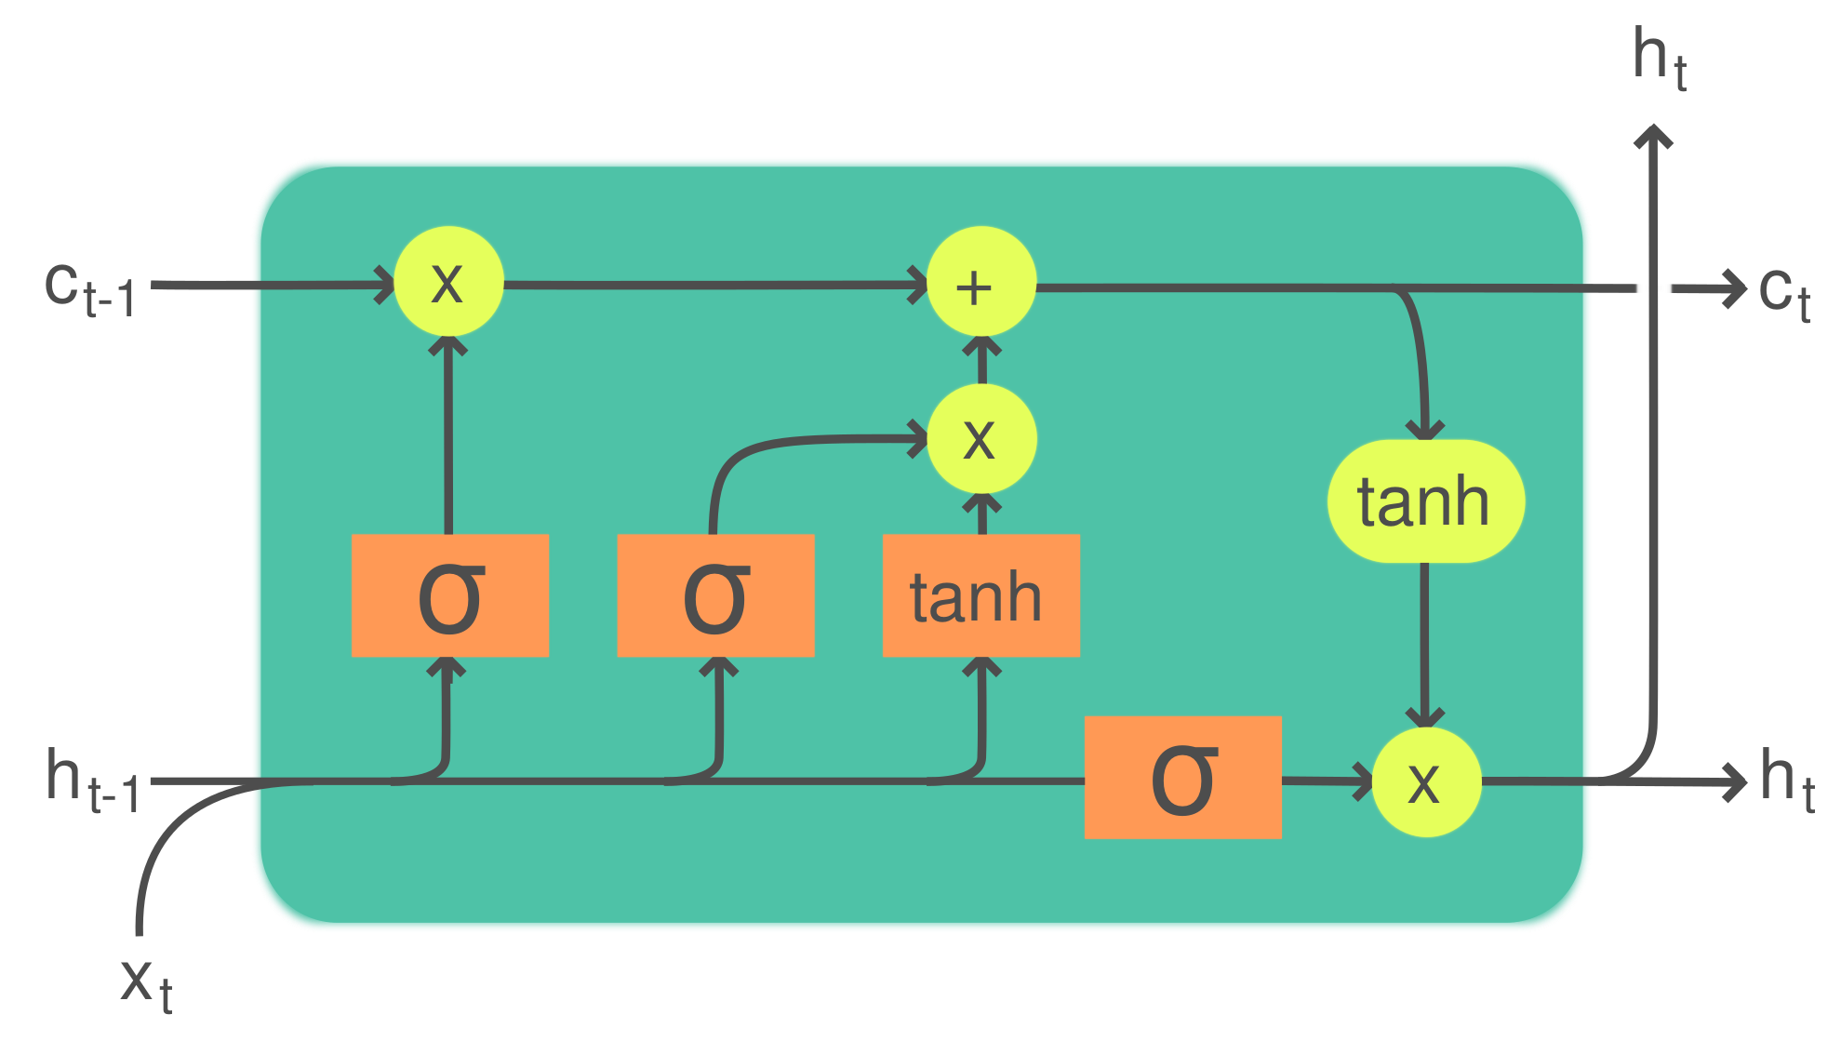
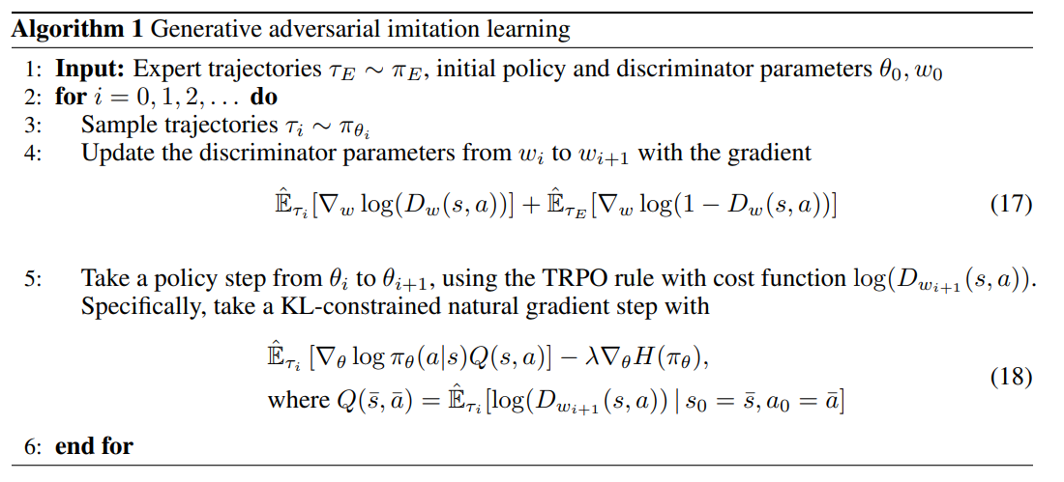
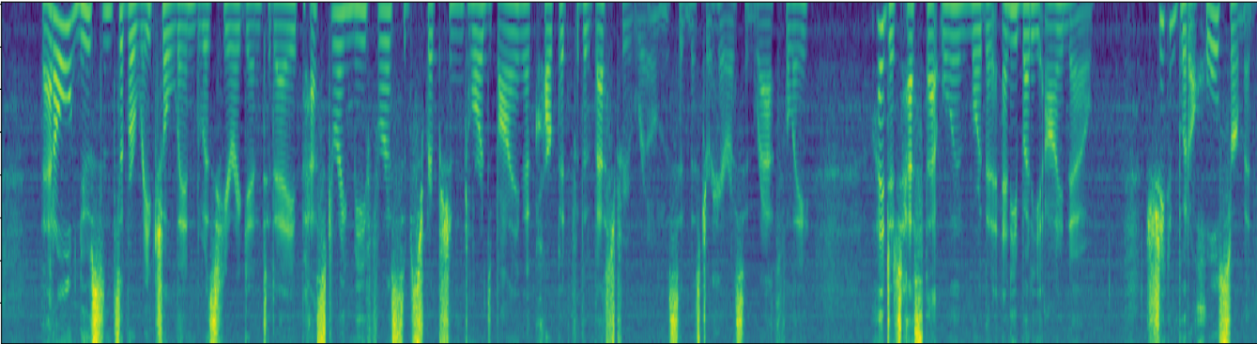
Computer Vision
Convolutional NNs (+ResNets)
Natural Lang. Proc.
Recurrent NNs (+LSTMs)
[2]
h e l l o
[1]
Speech
Deep Belief Nets (+non-DL)
Translation
Seq2Seq
RL
BC/GAIL
s a l u t </s>
RBM
DBN
RBM
🔒
DBN
GRBM
🔒
DBN
h e l l o </s> s a l u t
[1] CNN image CC-BY-SA by Aphex34 for Wikipedia https://commons.wikimedia.org/wiki/File:Typical_cnn.png
[2] RNN image CC-BY-SA by GChe for Wikipedia https://commons.wikimedia.org/wiki/File:The_LSTM_Cell.svg

Slide 4
The Transformer's takeover:
One community at a time

Slide 5

Computer Vision
Natural Lang. Proc.
Reinf. Learning
Speech
Translation
Graphs/Science
Transformer image source: "Attention Is All You Need" paper

Slide 6
The origins:
Translation, learned alignment

Slide 7
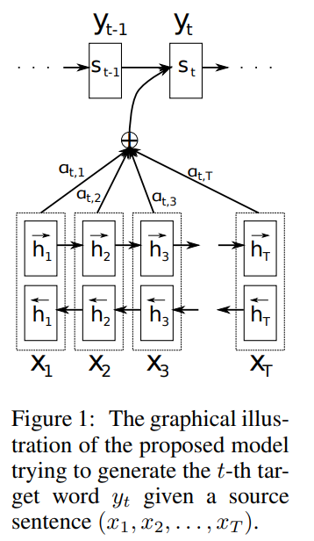
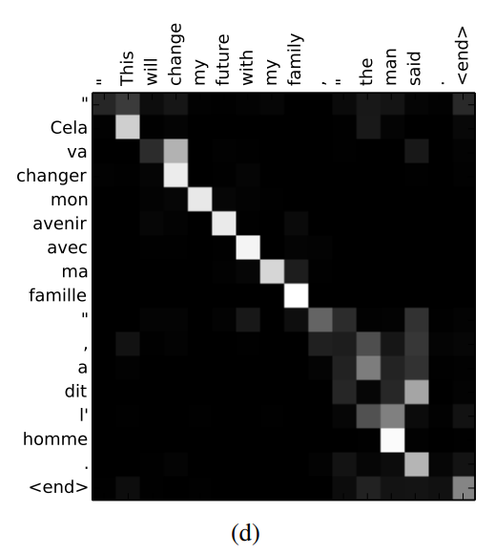
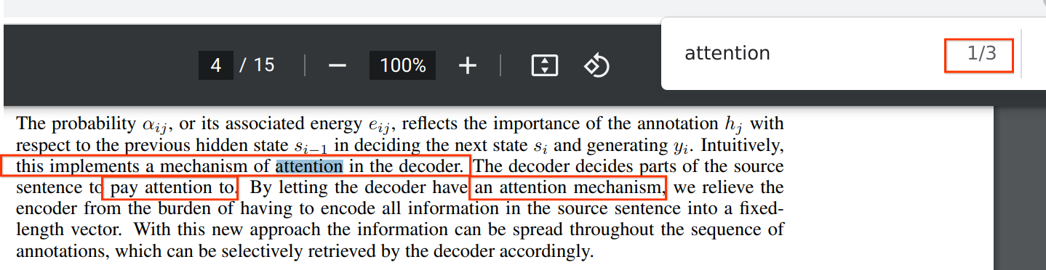
Neural Machine Translation by Jointly Learning to Align and Translate
2014, Dzmitry Bahdanau, KyungHyun Cho, Yoshua Bengio

Slide 8
Attention Is All You Need
2017, Ashish Vaswani, Noam Shazeer, Niki Parmar, Jakob Uszkoreit, Llion Jones, Aidan N. Gomez, Łukasz Kaiser, Illia Polosukhin
Attention is a function similar to a "soft" kv dictionary lookup:
1. Attention weights a_{1:N} are query-key similarities:
â_{i} = q · k_{i}
Normalized via softmax: a_{i} = e^{âi}/ ∑_{j}e^{âj}
Query q
Output z
Attention weights a
2. Output z is attention-weighted average of values v_{1:N}:
z = ∑_{i}â_{i}v_{i} = â · v
Keys k
...
...
Values v
3. Usually, k and v are derived from the same input x:
k = W_{k} · x v = W_{v} · x
The query q can come from a separate input y:
q = W_{q} · y
Or from the same input x! Then we call it "self attention":
q = W_{q} · x
W_{k}
W_{v}
Input x
...

Slide 9
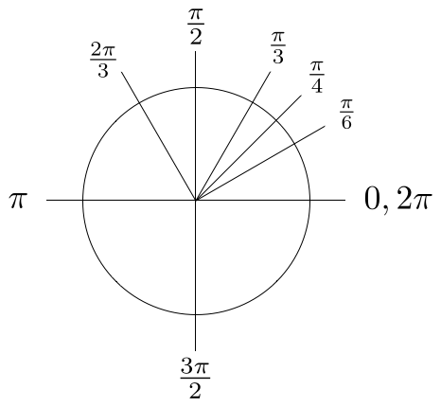
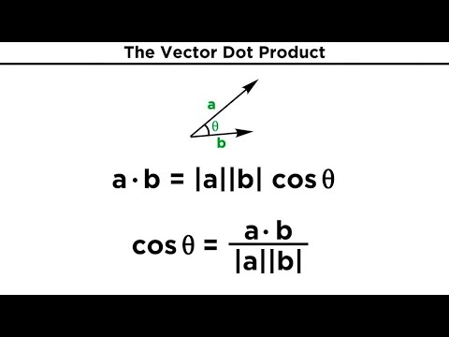
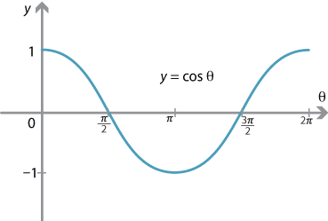
Dot product: Reminder

Slide 10
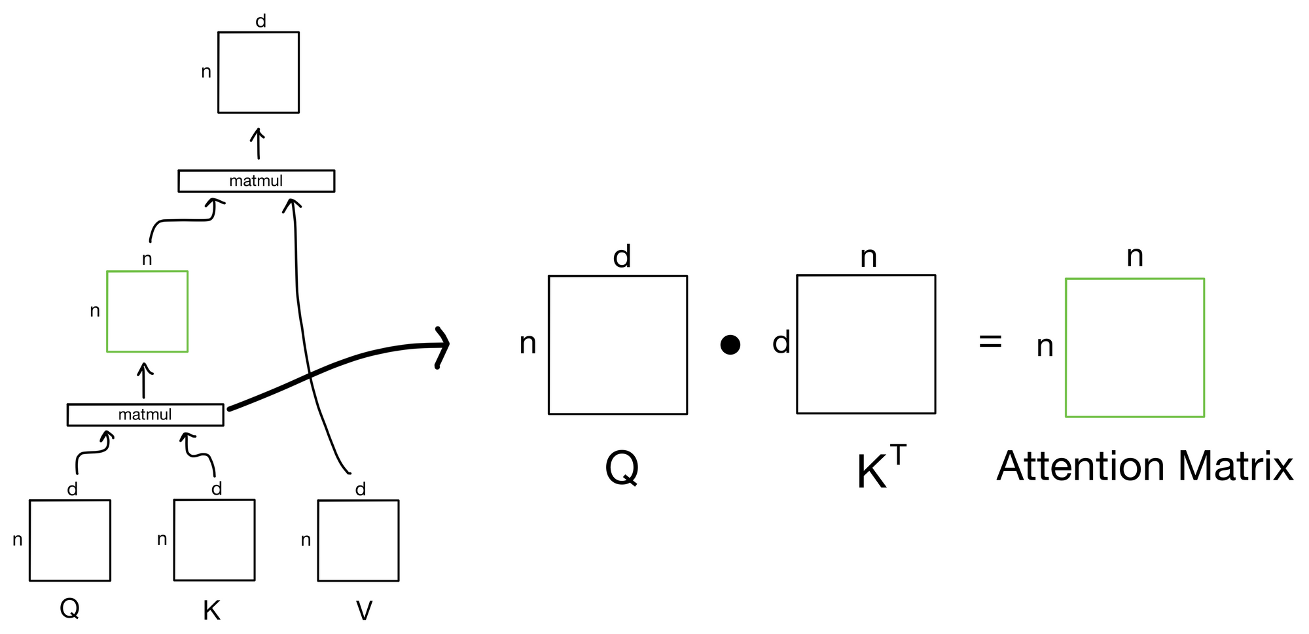
Attention: Detailed Explanations
3 components: Query, Key, Value
To make things easier, think of them as words of a sentence. Query = Key =Value (i.e., Self-attention)
Problem attention is trying to solve: Which word needs to look at which other words? Learn context
3 steps:
Linear projection: The Queries, Keys, and Values are independently projected using 1 FC Layer
Compute attention score: Attention scores are computed as the dot product of the query and key matrices, scaled by the square root of the each head dimension (i.e., normalize dot product results)
Retrieve values: attention weights are then multiplied by the value matrix to obtain the final attention output.

Slide 11
Attention Is All You Need
2017, Ashish Vaswani, Noam Shazeer, Niki Parmar, Jakob Uszkoreit, Llion Jones, Aidan N. Gomez, Łukasz Kaiser, Illia Polosukhin
But that's not actually it! There are a few more details:
1. We usually use many queries q_{1:M}, not just one.
Stacking them leads to the Attention matrix A_{1:N,1:M}
and subsequently to many outputs:
z_{1:M} = Attn(q_{1:M},x) = [Attn(q₁,x) | Attn(q₂,x) | ... | Attn(q_{M},x)]
Attention matrix A
Outputs z_{1:M}
Queries q_{1:M}
2. We usually use "multi-head" attention. This means the
operation is repeated K times and the results are
concatenated along the feature dimension. Ws differ.
Attn₁(q_{i},x)
z_{i} = ⎛Attn₂(q_{i},x) ⎞
....
⎝ Attn_{K}(q_{i},x)⎠
Attention matrix A
Attention matrix A
Outputs z_{1:M}
Queries q_{1:M}
Attention matrix A
Outputs z_{1:M}
Queries q_{1:M}
Attention matrix A
Outputs z_{1:M}
Queries q_{1:M}
Outputs z_{1:M}
Queries q_{1:M}
3. The most commonly seen formulation:
z = softmax(QK'/√d_{key})V
Note that the complexity is O(N²)
Attention matrix A
Attention matrix A
Queries q_{1:M}
Attention matrix A
Outputs z_{1:M}

Slide 12
Attention Is All You Need - The Transformer architecture
2017, Ashish Vaswani, Noam Shazeer, Niki Parmar, Jakob Uszkoreit, Llion Jones, Aidan N. Gomez, Łukasz Kaiser, Illia Polosukhin
Thanks to Basil Mustafa for slide inspiration
Transformer image source: "Attention Is All You Need" paper

Slide 13
Attention Is All You Need - The Transformer architecture
2017, Ashish Vaswani, Noam Shazeer, Niki Parmar, Jakob Uszkoreit, Llion Jones, Aidan N. Gomez, Łukasz Kaiser, Illia Polosukhin
Input (Tokenization and) Embedding
Input text is first split into pieces. Can be characters, word, "tokens":
"The detective investigated" -> [The_] [detective_] [invest] [igat] [ed_]
Tokens are indices into the "vocabulary":
[The_] [detective_] [invest] [igat] [ed_] -> [3 721 68 1337 42]
Each vocab entry corresponds to a learned d_{model}-dimensional vector.
[3 721 68 1337 42] -> [ [0.123, -5.234, ...], [...], [...], [...], [...] ]
Positional Encoding
Remember attention is permutation invariant, but language is not!
Need to encode position of each word; just add something.
Think [The_] + 10 [detective_] + 20 [invest] + 30 ... but smarter.
Thanks to Basil Mustafa for slide inspiration
Transformer image source: "Attention Is All You Need" paper

Slide 14
Attention Is All You Need - The Transformer architecture
2017, Ashish Vaswani, Noam Shazeer, Niki Parmar, Jakob Uszkoreit, Llion Jones, Aidan N. Gomez, Łukasz Kaiser, Illia Polosukhin
Multi-headed Self-Attention
Meaning the input sequence is used to create queries, keys, and values!
Each token can "look around" the whole input, and decide how to update its representation based on what it sees.
MHSA
[The_] [detective_] [invest] [igat] [ed_]
Thanks to Basil Mustafa for slide inspiration
Transformer image source: "Attention Is All You Need" paper

Slide 15
Attention Is All You Need - The Transformer architecture
2017, Ashish Vaswani, Noam Shazeer, Niki Parmar, Jakob Uszkoreit, Llion Jones, Aidan N. Gomez, Łukasz Kaiser, Illia Polosukhin
Point-wise MLP
A simple MLP applied to each token individually:
z_{i} = W₂ GeLU(W₁x + b₁) + b₂
Think of it as each token pondering for itself about what it has observed previously.
There's some weak evidence this is where "world knowledge" is stored, too.
GeLU
GeLU
GeLU
GeLU
GeLU
It contains the bulk of the parameters. When people make giant models and sparse/moe, this is what becomes giant.
[The_] [detective_] [invest] [igat] [ed_]
Some people like to call it 1x1 convolution.
Thanks to Basil Mustafa for slide inspiration
Transformer image source: "Attention Is All You Need" paper

Slide 16
Attention Is All You Need - The Transformer architecture
2017, Ashish Vaswani, Noam Shazeer, Niki Parmar, Jakob Uszkoreit, Llion Jones, Aidan N. Gomez, Łukasz Kaiser, Illia Polosukhin
Residual connections
"Skip connection"
"Residual block"
Each module's output has the exact same shape as its input.
Following ResNets, the module computes a "residual" instead of a new value:
z_{i} = Module(x_{i}) + x_{i}
This was shown to dramatically improve trainability.
+
+
Block
Block
LayerNorm
Normalization also dramatically improves trainability.
There's post-norm (original) and pre-norm (modern)
z_{i} = LN(Module(x_{i}) + x_{i})
z_{i} = Module(LN(x_{i})) + x_{i}
Thanks to Basil Mustafa for slide inspiration
Transformer image source: "Attention Is All You Need" paper

Slide 17
Attention Is All You Need - The Transformer architecture
2017, Ashish Vaswani, Noam Shazeer, Niki Parmar, Jakob Uszkoreit, Llion Jones, Aidan N. Gomez, Łukasz Kaiser, Illia Polosukhin
Encoding / Encoder
Since input and output shapes are identical, we can stack N such blocks.
Typically, N=6 ("base"), N=12 ("large") or more.
Encoder output is a "heavily processed" (think: "high level, contextualized") version of the input tokens, i.e. a sequence.
This has nothing to do with the requested output yet (think: translation). That comes with the decoder.
Thanks to Basil Mustafa for slide inspiration
Transformer image source: "Attention Is All You Need" paper

Slide 18
Attention Is All You Need - The Transformer architecture
2017, Ashish Vaswani, Noam Shazeer, Niki Parmar, Jakob Uszkoreit, Llion Jones, Aidan N. Gomez, Łukasz Kaiser, Illia Polosukhin
p(z₃|z₂,z₁,x)
Decoding / the Decoder (alternatively Generating / the Generator)
What we want to model: p(z|x)
for example, in translation: p(z | "the detective investigated") ∀z
x
Seems impossible at first, but we can exactly decompose into tokens:
p(z|x) = p(z₁|x) p(z₂|z₁,x) p(z₃|z₂,z₁,x)...
Meaning, we can generate the answer one token at a time.
Each p is a full pass through the model.
For generating p(z₃|z₂,z₁,x):
x comes from the encoder,
z₁, z₂ is what we have predicted so far, goes into the decoder.
Once we have p(z|x) we still need to actually sample a sentence such as "le détective a enquêté". Many strategies: greedy, beam-search, ...
z₁, z₂
Thanks to Basil Mustafa for slide inspiration
Transformer image source: "Attention Is All You Need" paper

Slide 19
Attention Is All You Need - The Transformer architecture
2017, Ashish Vaswani, Noam Shazeer, Niki Parmar, Jakob Uszkoreit, Llion Jones, Aidan N. Gomez, Łukasz Kaiser, Illia Polosukhin
Masked self-attention
This is regular self-attention as in the encoder, to process what's been decoded so far, but with a trick...
If we had to train on one single p(z₃|z₂,z₁,x) at a time: SLOW!
Instead, train on all p(z_{i}|z_{1:i},x) simultaneously.
How? In the attention weights for z_{i}, set all entries i:N to 0.
This way, each token only sees the already generated ones.
At generation time
There is no such trick. We need to generate one z_{i} at a time. This is why autoregressive decoding is extremely slow.
Thanks to Basil Mustafa for slide inspiration
Transformer image source: "Attention Is All You Need" paper

Slide 20
Attention Is All You Need - The Transformer architecture
2017, Ashish Vaswani, Noam Shazeer, Niki Parmar, Jakob Uszkoreit, Llion Jones, Aidan N. Gomez, Łukasz Kaiser, Illia Polosukhin
"Cross" attention
Each decoded token can "look at" the encoder's output:
Attn(q=W_{q}x_{dec}, k=W_{k}x_{enc}, v=W_{v}x_{enc})
This is the same as in the 2014 paper.
This is where |x in p(z₃|z₂,z₁,x) comes from.
x_{enc}
x_{dec}
Because self-attention is so widely used, people have started just calling it "attention".
Hence, we now often need to explicitly call this "cross attention".
Thanks to Basil Mustafa for slide inspiration
Transformer image source: "Attention Is All You Need" paper ; heatmap image source: "Neural Machine Translation by Jointly Learning to Align and Translate" paper

Slide 21
Attention Is All You Need - The Transformer architecture
2017, Ashish Vaswani, Noam Shazeer, Niki Parmar, Jakob Uszkoreit, Llion Jones, Aidan N. Gomez, Łukasz Kaiser, Illia Polosukhin
Feedforward and stack layers.
Thanks to Basil Mustafa for slide inspiration
Transformer image source: "Attention Is All You Need" paper

Slide 22
Attention Is All You Need - The Transformer architecture
2017, Ashish Vaswani, Noam Shazeer, Niki Parmar, Jakob Uszkoreit, Llion Jones, Aidan N. Gomez, Łukasz Kaiser, Illia Polosukhin
Output layer
Assume we have already generated K tokens, generate the next one.
The decoder was used to gather all information necessary to predict a probability distribution for the next token (K), over the whole vocab.
Simple:
linear projection of token K
SoftMax normalization
Thanks to Basil Mustafa for slide inspiration
Transformer image source: "Attention Is All You Need" paper

Slide 23

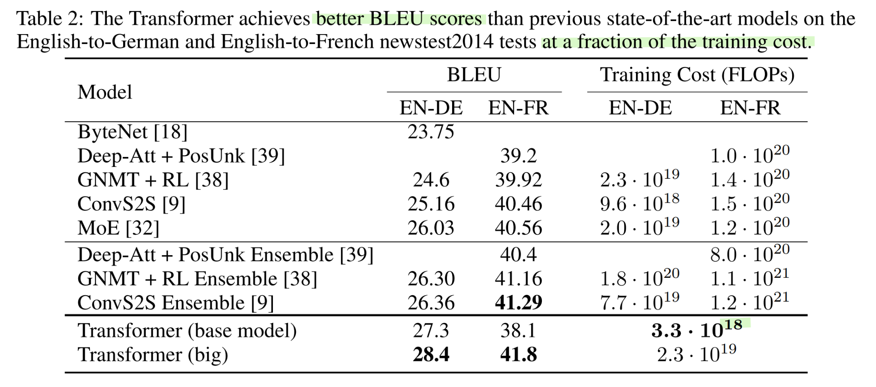
Attention Is All You Need - Summary and results
2017, Ashish Vaswani, Noam Shazeer, Niki Parmar, Jakob Uszkoreit, Llion Jones, Aidan N. Gomez, Łukasz Kaiser, Illia Polosukhin
Animation source: https://ai.googleblog.com/2017/08/transformer-novel-neural-network.html
Table source: "Attention Is All You Need" paper

Slide 24
The first (1.5th) big takeover:
Language Modeling / NLP

Slide 25
Decoder-only
GPT
Encoder-only
BERT
Enc-Dec
T5
Das ist gut.
A storm in Attala caused 6 victims.
This is not toxic.
[sat_]
[*] [*] [sat_] [*] [the_] [*]
Translate EN-DE: This is good.
Summarize: state authorities dispatched…
Is this toxic: You look beautiful today!
[START] [The_] [cat_]
[The_] [cat_] [MASK] [on_] [MASK] [mat_]
Transformer image source: "Attention Is All You Need" paper

Slide 26
The second big takeover:
Computer Vision

Slide 27
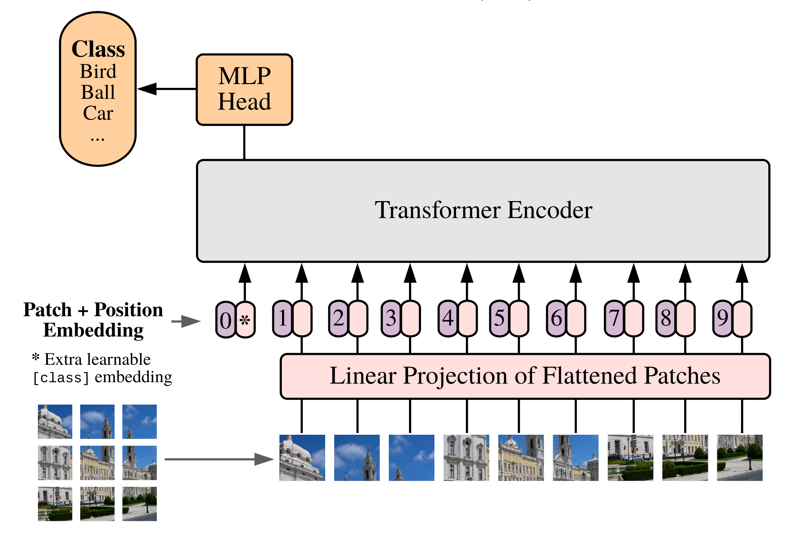
An Image is Worth 16x16 Words: Transformers for Image Recognition at Scale
2020, A Dosovitskiy, L Beyer, A Kolesnikov, D Weissenborn, X Zhai, T Unterthiner, M Dehghani, M Minderer, G Heigold, S Gelly, J Uszkoreit, N Houlsby
Vision Transformer (ViT)
Many prior works attempted to introduce self-attention at the pixel level.
For 224px², that's 50k sequence length, too much!
Thus, most works restrict attention to local pixel neighborhoods, or as high-level mechanism on top of detections.
The key breakthrough in using the full Transformer architecture, standalone, was to "tokenize" the image by cutting it into patches of 16px², and treating each patch as a token, e.g. embedding it into input space.

Slide 28
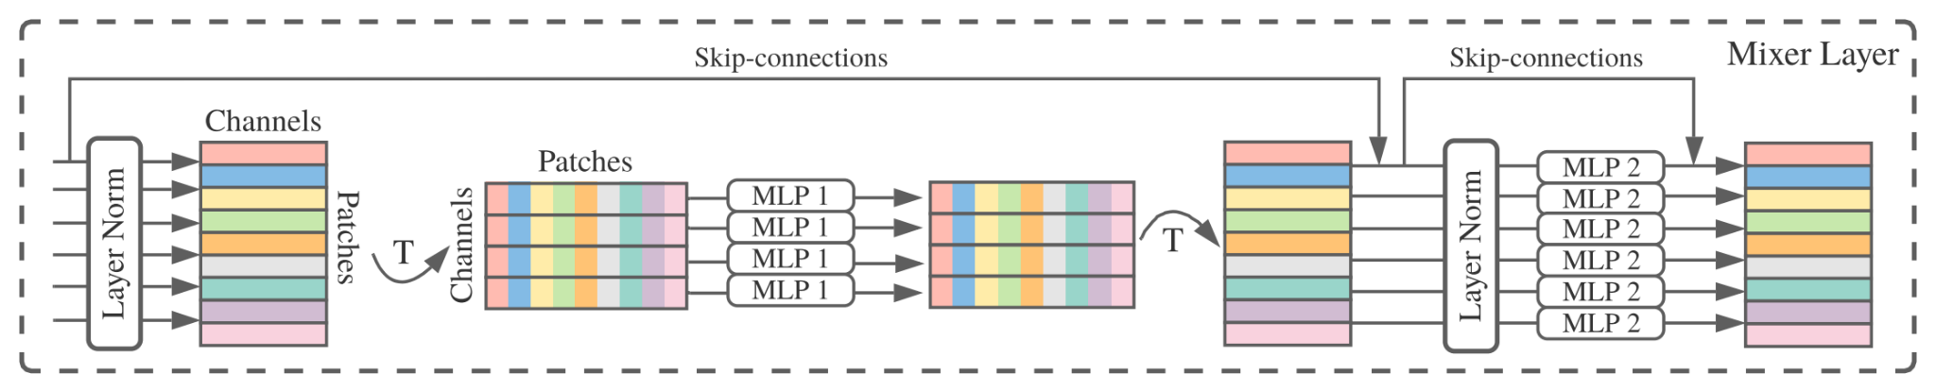
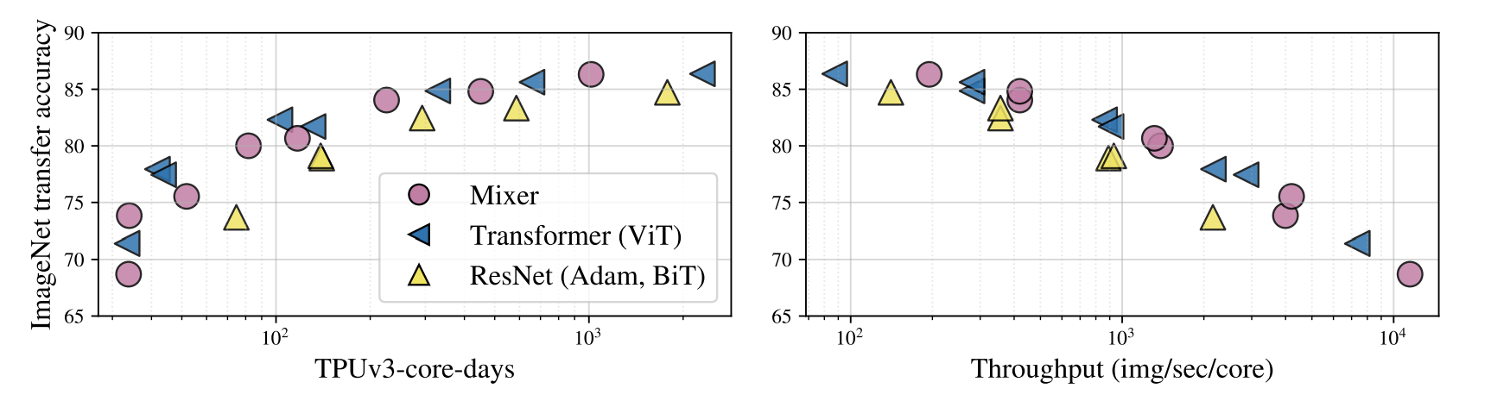
Side-note: MLP-Mixer
2020, I Tolstikhin, N Houlsby, A Kolesnikov, L Beyer, X Zhai, T Unterthiner, J Yung, A Steiner, D Keysers, J Uszkoreit, M Lucic, A Dosovitskiy
After ViT answered the question "Are convolutions really needed to process images?" with NO...
We wondered if self-attention is really needed?
The role of self-attention is to "mix" information across tokens.
Another simple way to achieve this, is to "transpose" tokens and run that through an MLP:

Slide 29
The third big takeover:
Speech

Slide 30
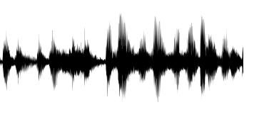
Conformer: Convolution-augmented Transformer for Speech Recognition
2020, A Gulati, J Qin, C-C Chiu, N Parmar, Y Zhang, J Yu, W Han, S Wang, Z Zhang, Y Wu, R Pang
[igat]
Largely the same story as in computer vision.
But with spectrograms instead of images.
Add a third type of block using convolutions, and slightly reorder blocks, but overall very transformer-like.
[The_] [detective_] [invest]
Exists as encoder-decoder variant, or as encoder-only variant with CTC loss.
Transformer image source: "Attention Is All You Need" paper

Slide 31
The fourth big takeover:
Reinforcement Learning

Slide 32
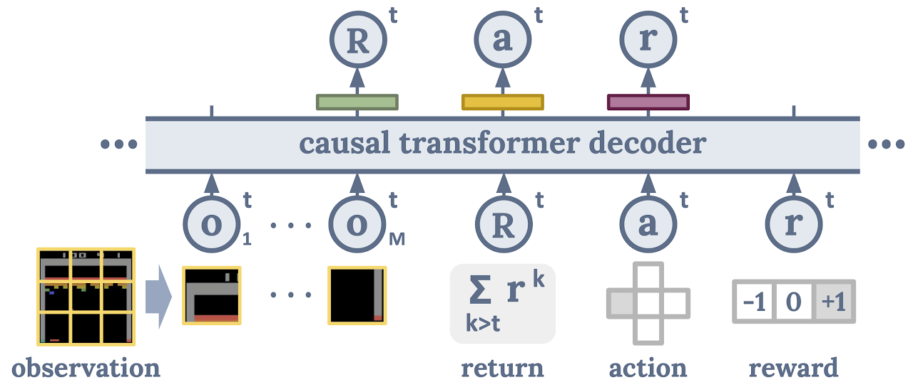
Decision Transformer: Reinforcement Learning via Sequence Modeling
2021, L Chen, K Lu, A Rajeswaran, K Lee, A Grover, M Laskin, P Abbeel, A Srinivas, I Mordatch
Cast the (supervised/offline) RL problem into a sequence ("language") modeling task:
Can generate/decode sequences of actions with desired return (eg skill)
The trick is prompting: "The following is a trajectory of an expert player: [obs] ..."
Slide credit: Igor Mordatch

Slide 33
The Transformer's
Unification of communities

Slide 34
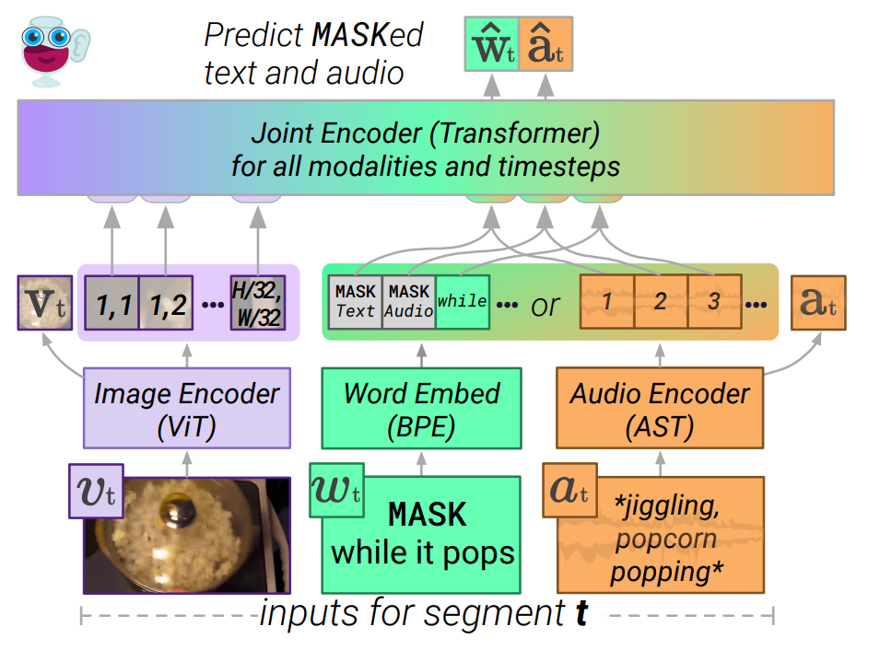

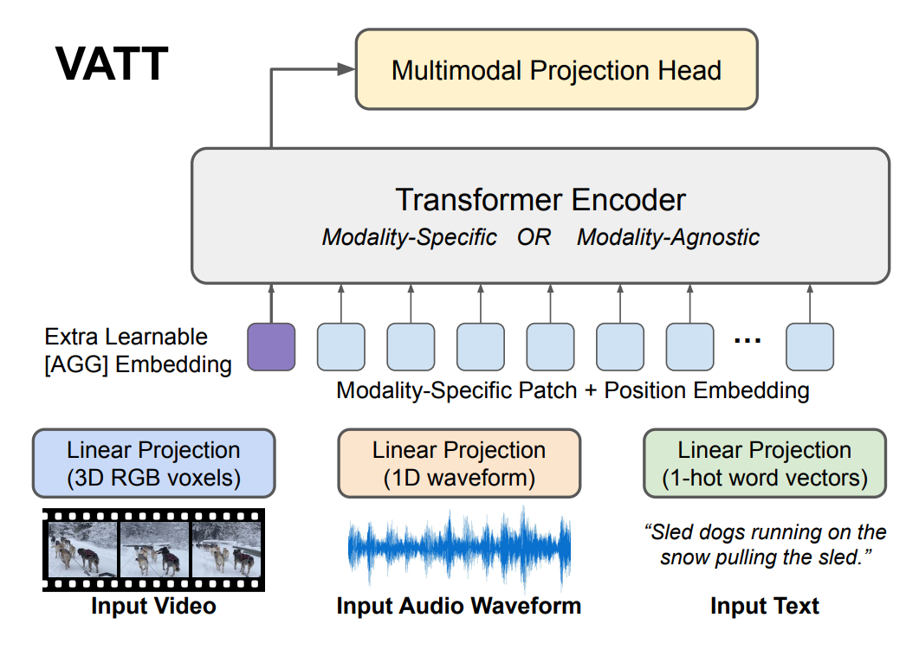
Anything you can tokenize, you can feed to Transformer
ca 2021 and onwards
[2]
Tokenize different modalities each in their own way (some kind of "patching"), and send them all jointly into a Transformer...
Seems to just work...
Currently an explosion of works doing this!
[3]
[1]
Images from:
[1] LIMoE by B Mustafa, C Riquelme, J Puigcerver, R Jenatton, N Houlsby
[2] MERLOT Reserve by R Zellers, J Lu, X Lu, Y Yu, Y Zhao, M Salehi, A Kusupati, J Hessel, A Farhadi, Y Choi
[3] VATT by H Akbari, L Yuan, R Qian, W-H Chuang, S-F Chang, Y Cui, B Gong

Slide 35
A note on
Efficient Transformers

Slide 36
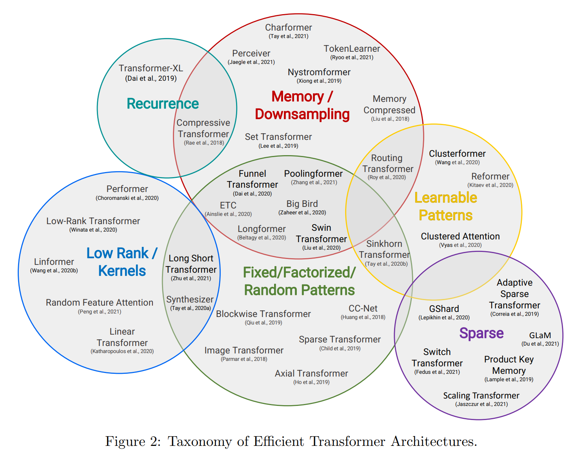
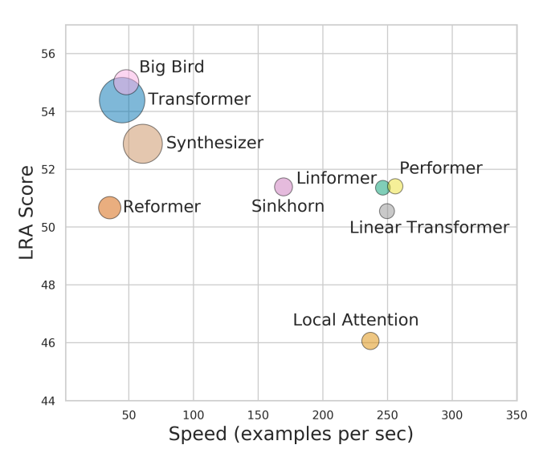
A note on Efficient Transformers
The self-attention operation complexity is O(N²) for sequence length N.
We'd like to use large N:
Whole articles or books
Full video movies
High resolution images
Many O(N) approximations to the full self-attention have been proposed in the past two years.
Unfortunately, none provides a clear improvement.
They always trade-off between speed and quality.
Based on "Efficient Transformers: A Survey" by Yi Tay, Mostafa Dehghani, Dara Bahri, Donald Metzler
and "Long Range Arena: A Benchmark for Efficient Transformers" by Y Tay, M Dehghani, S Abnar, Y Shen, D Bahri, P Pham, J Rao, L Yang, S Ruder, D Metzler

Slide 37
Thanks for your... 🥁
Attention
Transformer image source: "Attention Is All You Need" paper

